Slide 1
Experiment results

Slide 2
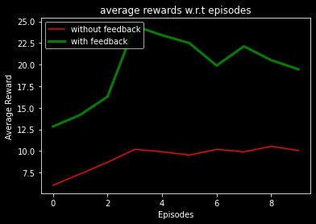
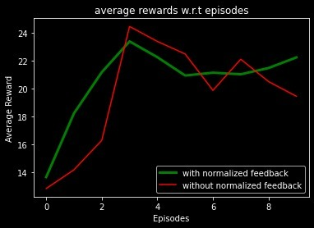
Trail 1:- (No of steps = 50)
With feedback vs without feedback
With normalized feedback vs without normalized feedback

Slide 3
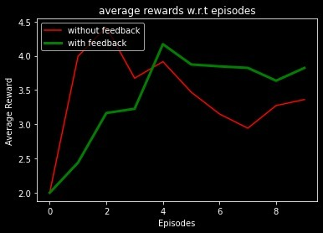
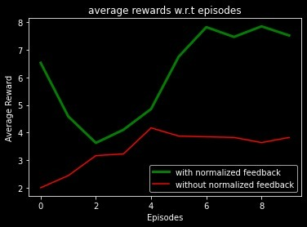
Trail2:- (No of steps = 20)
With feedback vs without feedback
With normalized feedback vs without normalized feedback

Slide 4
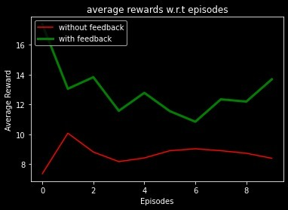
Trail3:- (No of steps = 50)
With feedback vs without feedback

Slide 5
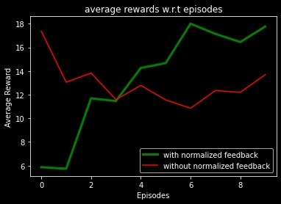
With normalized feedback vs without normalized feedback

Slide 6
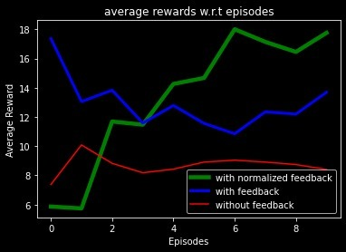
With normalized feedback vs without normalized feedback vs without feedback

